Slide 1
Report batch 20230508_MW12

Slide 2
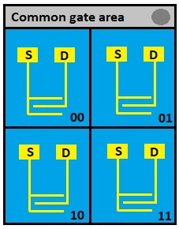
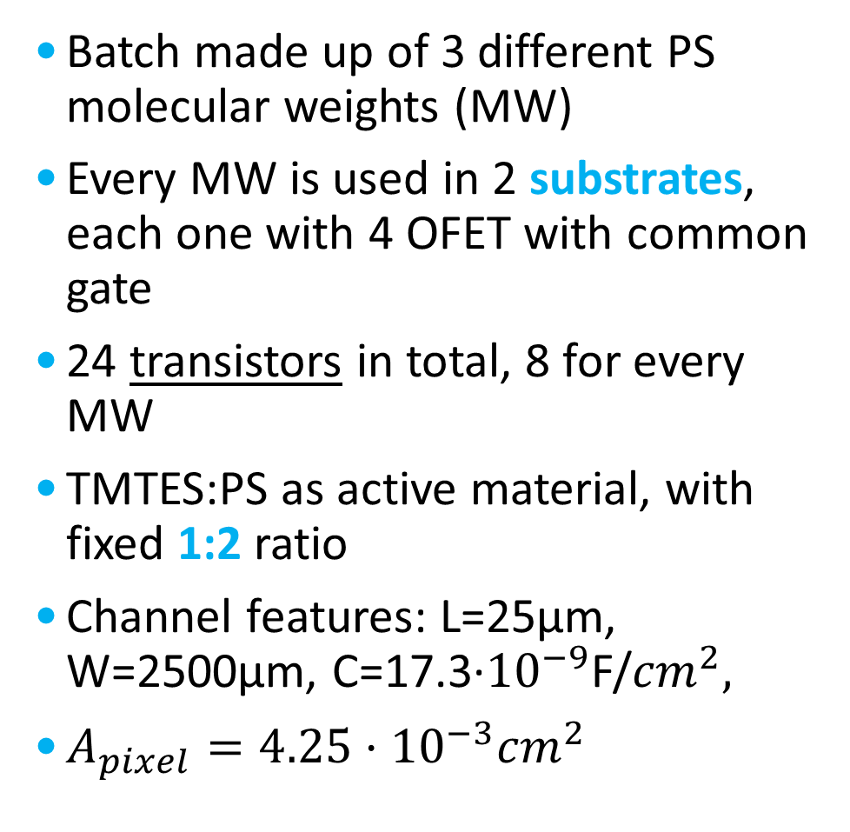
General features
Batch made up of 3 different PS molecular weights (MW)
Every MW is used in 2 substrates, each one with 4 OFET with common gate
24 transistors in total, 8 for every MW
TMTES:PS as active material, with fixed 1:2 ratio
Channel features: L=25µm, W=2500µm, C=17.3·${10}^{−9}$F/${cm}^{2},$
$A_{pixel}={4.25·10}^{−3}{cm}^{2}$

Slide 3
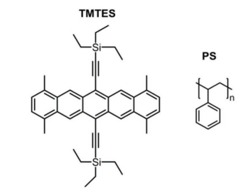
Compositions
TMTES:PS ratio is fixed at 1:2, but the molecular weight of PS (a polymer with variable chain length) is varied
280K: Sample5 and Sample6
100K: Sample11 and Sample12
10K: Sample17 and Sample18
Tamayo A., Fratelli I., Ciavatti A., Martínez-Domingo C., Branchini P., Colantoni E., de Rosa S., Tortora L., Contillo A., Santiago R., Bromley S. T., Fraboni B., Mas-Torrent M., Basiricò L., X-ray Detectors With Ultrahigh Sensitivity Employing High Performance Transistors Based on a Fully Organic Small Molecule Semiconductor/Polymer Blend Active, 2022

Slide 4
X-rays measurements: Current normalization
Polynomial fit before irradiation

Slide 5
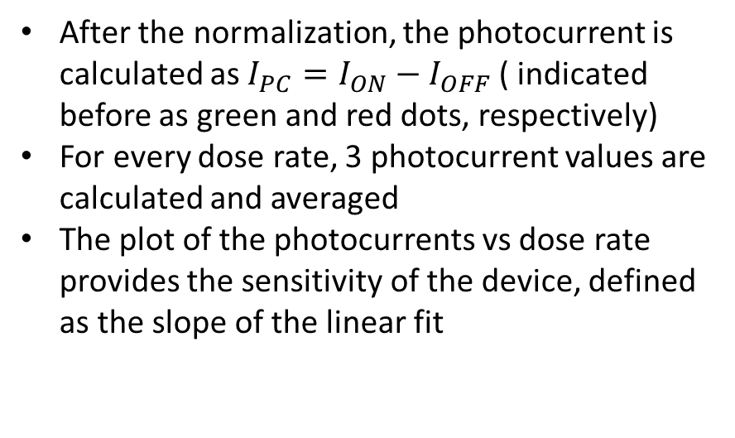
X-rays measurements: sensitivity calculation
After the normalization, the photocurrent is calculated as ${I_{PC}=I}_{ON}−I_{OFF}$ ( indicated before as green and red dots, respectively)
For every dose rate, 3 photocurrent values are calculated and averaged
The plot of the photocurrents vs dose rate provides the sensitivity of the device, defined as the slope of the linear fit

Slide 6
280K samples

Slide 7

280K samples
Transfer characteristics
Output characteristic (example)
:Working point ($V_{SG}=−2.5V, V_{SD}=−10V$)

Slide 8
280K: Current curves

Slide 9
280K: Photocurrent

Slide 10
280K: Transfer characteristic

Slide 11
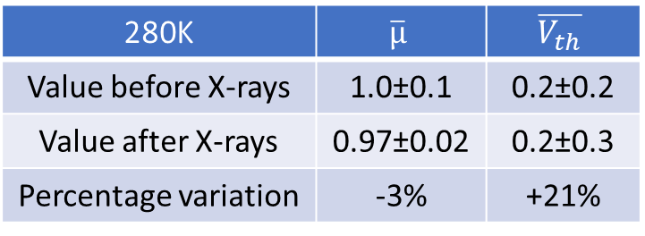
280K: Transfer before and after X-rays
280K | $$\overline{µ}$$ | $$\overline{V_{th}}$$
Value before X-rays | 1.0±0.1 | 0.2±0.2
Value after X-rays | 0.97±0.02 | 0.2±0.3
Percentage variation | -3% | +21%

Slide 12
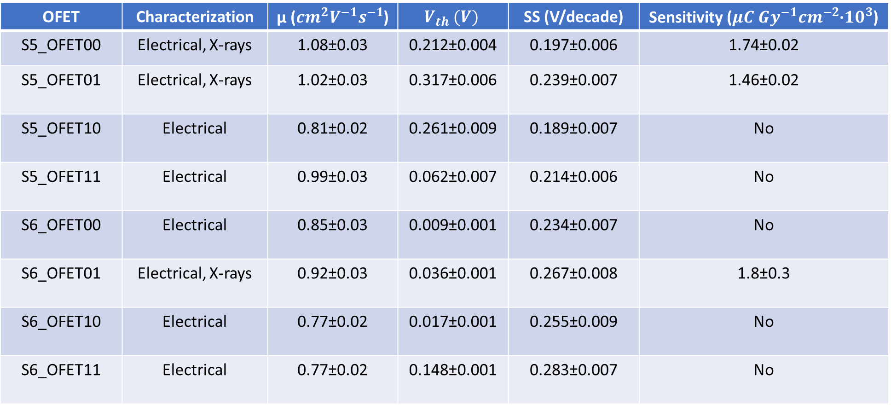
Summary table: 280K
OFET | Characterization | µ (${cm}^{2}V^{−1}s^{−1}$) | $$V_{th} (V)$$ | SS (V/decade) | Sensitivity (${{μC Gy}^{−1}cm}^{−2}$·${10}^{3}$)
S5_OFET00 | Electrical, X-rays | 1.08±0.03 | 0.212±0.004 | 0.197±0.006 | 1.74±0.02
S5_OFET01 | Electrical, X-rays | 1.02±0.03 | 0.317±0.006 | 0.239±0.007 | 1.46±0.02
S5_OFET10 | Electrical | 0.81±0.02 | 0.261±0.009 | 0.189±0.007 | No
S5_OFET11 | Electrical | 0.99±0.03 | 0.062±0.007 | 0.214±0.006 | No
S6_OFET00 | Electrical | 0.85±0.03 | 0.009±0.001 | 0.234±0.007 | No
S6_OFET01 | Electrical, X-rays | 0.92±0.03 | 0.036±0.001 | 0.267±0.008 | 1.8±0.3
S6_OFET10 | Electrical | 0.77±0.02 | 0.017±0.001 | 0.255±0.009 | No
S6_OFET11 | Electrical | 0.77±0.02 | 0.148±0.001 | 0.283±0.007 | No
$\overline{µ}=(\text{0.9}\text{±}0.1){cm}^{2}V^{−1}s^{−1}, \overline{V_{th}}=\left(0.\text{1}\text{±}0.1\right) V, \overline{SS}=\left(0.\text{23}\text{±}0.03\right)V/decade$, $\overline{S}=(1.7±0.2)µC{Gy}^{−1}{cm}^{−2}{•10}^{3}$

Slide 13
100K samples

Slide 14

100K samples
Transfer characteristics
Output characteristic (example)
:Working point ($V_{SG}=−2.5V, V_{SD}=−10V$)

Slide 15
100K: Current curves

Slide 16
100K: Photocurrent

Slide 17
100K: Transfer characteristic

Slide 18
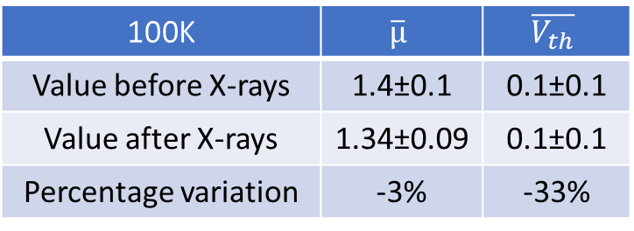
100K: Transfer before and after X-rays
100K | $$\overline{µ}$$ | $$\overline{V_{th}}$$
Value before X-rays | 1.4±0.1 | 0.1±0.1
Value after X-rays | 1.34±0.09 | 0.1±0.1
Percentage variation | -3% | -33%

Slide 19
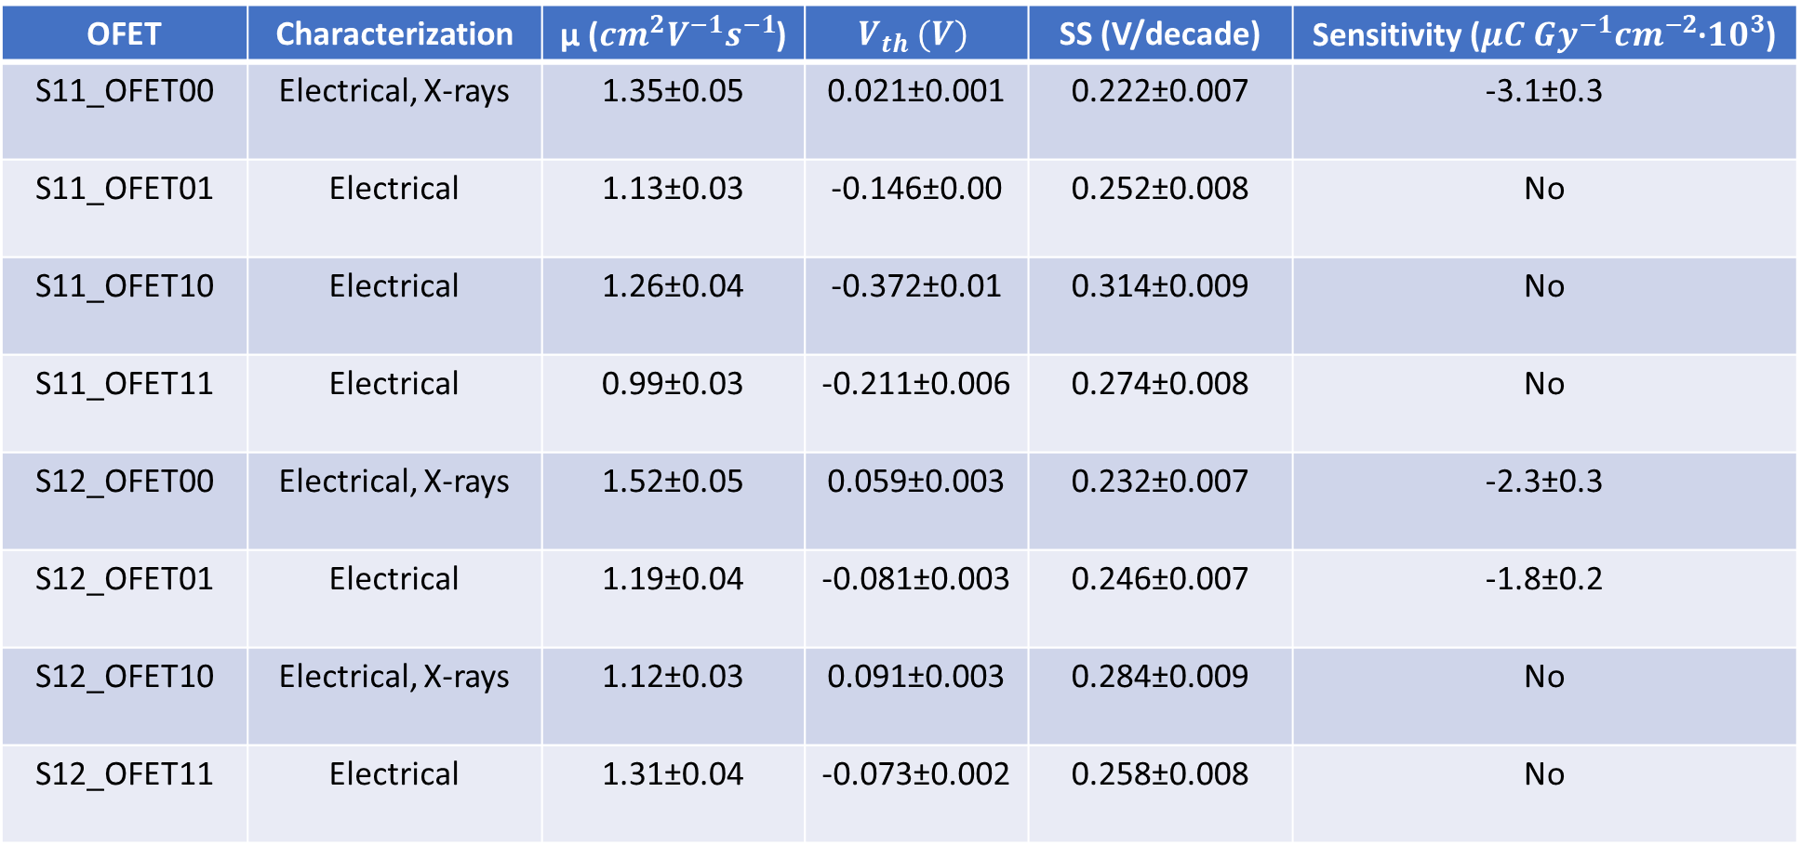
Summary table: 100K
OFET | Characterization | µ (${cm}^{2}V^{−1}s^{−1}$) | $$V_{th} (V)$$ | SS (V/decade) | Sensitivity (${{μC Gy}^{−1}cm}^{−2}$·${10}^{3}$)
S11_OFET00 | Electrical, X-rays | 1.35±0.05 | 0.021±0.001 | 0.222±0.007 | -3.1±0.3
S11_OFET01 | Electrical | 1.13±0.03 | -0.146±0.00 | 0.252±0.008 | No
S11_OFET10 | Electrical | 1.26±0.04 | -0.372±0.01 | 0.314±0.009 | No
S11_OFET11 | Electrical | 0.99±0.03 | -0.211±0.006 | 0.274±0.008 | No
S12_OFET00 | Electrical, X-rays | 1.52±0.05 | 0.059±0.003 | 0.232±0.007 | -2.3±0.3
S12_OFET01 | Electrical | 1.19±0.04 | -0.081±0.003 | 0.246±0.007 | -1.8±0.2
S12_OFET10 | Electrical, X-rays | 1.12±0.03 | 0.091±0.003 | 0.284±0.009 | No
S12_OFET11 | Electrical | 1.31±0.04 | -0.073±0.002 | 0.258±0.008 | No
$\overline{µ}=\text{(1.3}\text{±}\text{0.}2) {cm}^{2}V^{−1}s^{−1}, \overline{V_{th}}=\left(−0.1±0.2\right) V, \overline{SS}=\left(0.26±0.03\right)V/decade$, $\overline{S}=(−2.5±0.7)µC{Gy}^{−1}{cm}^{−2}{•10}^{3}$

Slide 20
10K samples

Slide 21

10K samples
Transfer characteristics
Output characteristic (example)
:Working point ($V_{SG}=−2.5V, V_{SD}=−10V$)

Slide 22
10K: Current curves

Slide 23
10K: Photocurrent

Slide 24
10K: Transfer characteristic

Slide 25
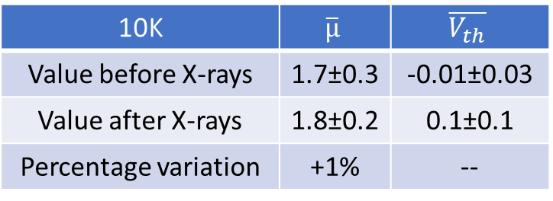
10K: Transfer before and after X-rays
10K | $$\overline{µ}$$ | $$\overline{V_{th}}$$
Value before X-rays | 1.7±0.3 | -0.01±0.03
Value after X-rays | 1.8±0.2 | 0.1±0.1
Percentage variation | +1% | --

Slide 26
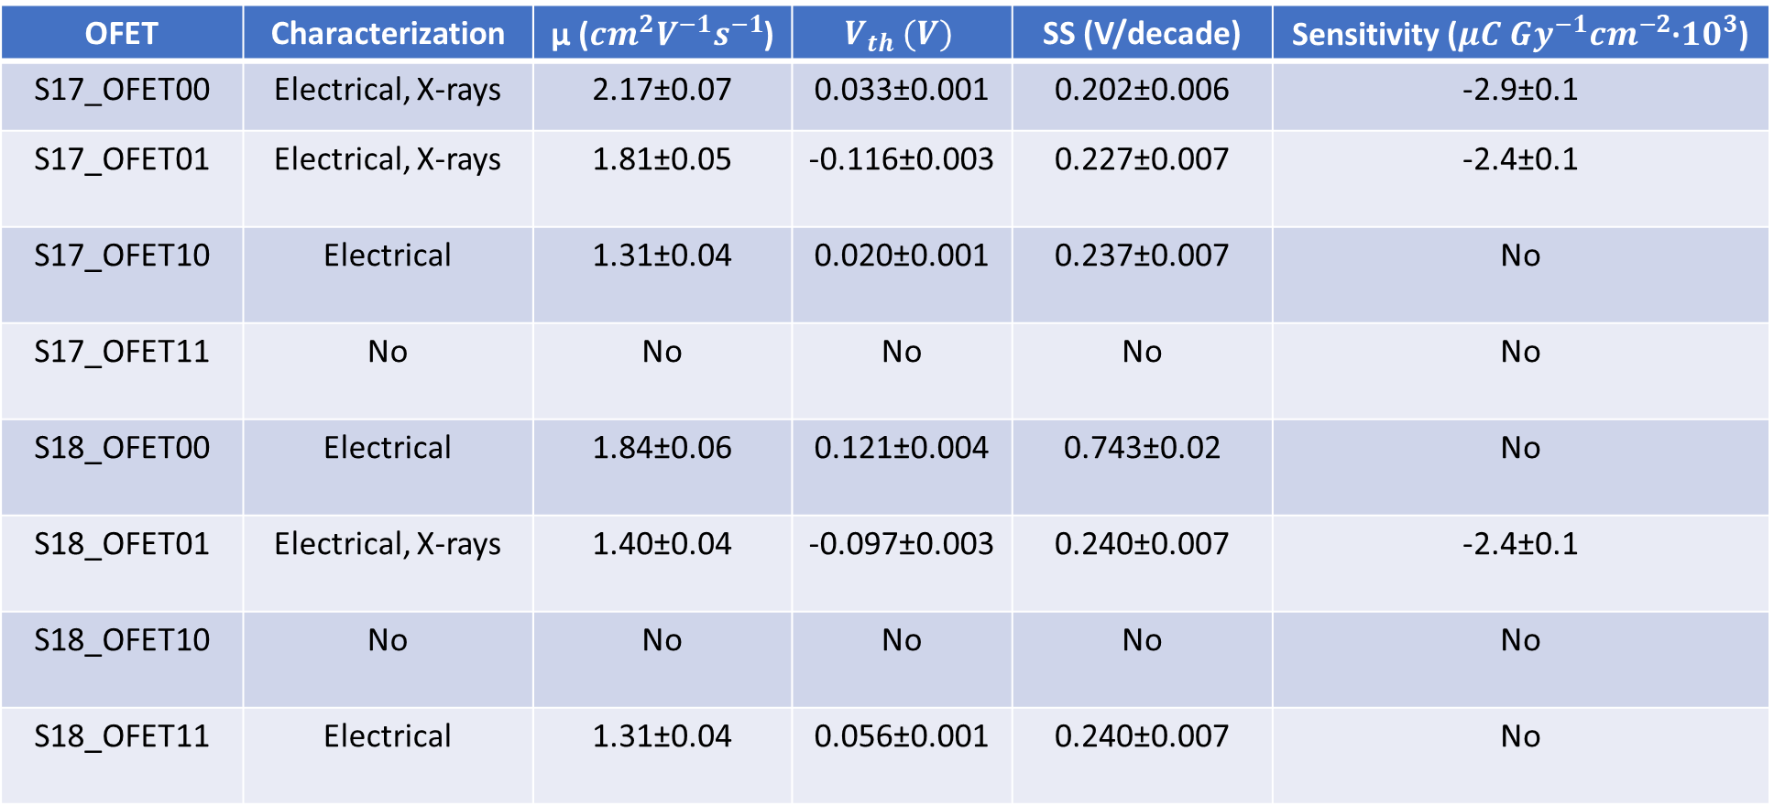
Summary table: 10K
OFET | Characterization | µ (${cm}^{2}V^{−1}s^{−1}$) | $$V_{th} (V)$$ | SS (V/decade) | Sensitivity (${{μC Gy}^{−1}cm}^{−2}$·${10}^{3}$)
S17_OFET00 | Electrical, X-rays | 2.17±0.07 | 0.033±0.001 | 0.202±0.006 | -2.9±0.1
S17_OFET01 | Electrical, X-rays | 1.81±0.05 | -0.116±0.003 | 0.227±0.007 | -2.4±0.1
S17_OFET10 | Electrical | 1.31±0.04 | 0.020±0.001 | 0.237±0.007 | No
S17_OFET11 | No | No | No | No | No
S18_OFET00 | Electrical | 1.84±0.06 | 0.121±0.004 | 0.743±0.02 | No
S18_OFET01 | Electrical, X-rays | 1.40±0.04 | -0.097±0.003 | 0.240±0.007 | -2.4±0.1
S18_OFET10 | No | No | No | No | No
S18_OFET11 | Electrical | 1.31±0.04 | 0.056±0.001 | 0.240±0.007 | No
$\overline{µ}=\text{(1.6}\text{±}\text{0.}4){cm}^{2}V^{−1}s^{−1}, \overline{V_{th}}=\left(−0.02±0.09\right) V, \overline{SS}=\left(0.3±0.2\right)V/decade$, $\overline{S}=(−2.5±0.3)µC{Gy}^{−1}{cm}^{−2}{•10}^{3}$

Slide 27
Composition comparisons

Slide 28
Transfer characteristic
Samples with 280K molecular weight produce less current than 100K and 10K at same bias
This leads to worse values of mobility and SS for 280K compared to 10K and 100K samples (next graphs)

Slide 29
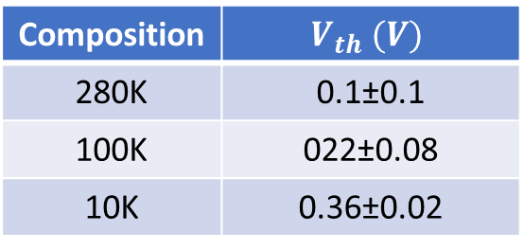
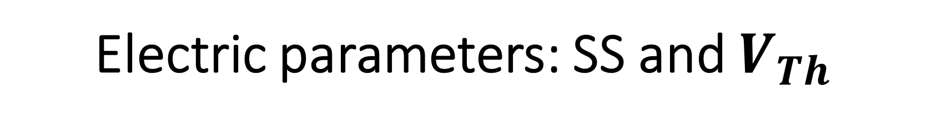
Electric parameters: SS and $V_{Th}$
Composition | SS (V/decade)
280K | 0.23±0.03
100K | 0.26±0.03
10K | 0.23±0.02
Composition | $$V_{th} (V)$$
280K | 0.1±0.1
100K | 022±0.08
10K | 0.36±0.02

Slide 30
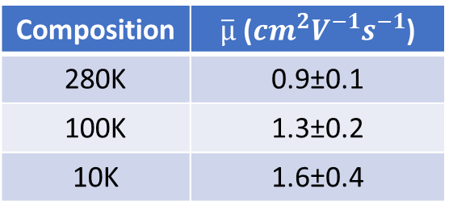
Electric parameters: mobility
Composition | $\overline{µ}$ (${cm}^{2}V^{−1}s^{−1}$)
280K | 0.9±0.1
100K | 1.3±0.2
10K | 1.6±0.4

Slide 31
X-rays detection: currents in time
In all compositions, the current drops continuously during the first DR irradiation (much more than in previous batches)
As irradiation takes place, the current starts to rise again
No major difference among compositions in current trends

Slide 32
X-rays detection: normalized currents
«Triangle-like» shapes for 100K and 10K samples photocurrents
6.640mGy/s DR problematic to evaluate due to I(t) curve shape (see previous slide)

Slide 33
X-rays detection: sensitivities
The sensitivity of every molecular weight was evaluated from three samples
100K and 10K samples show (comparable) negative sensitivities
280K samples sensitivity is lower in module with respect to 100K and 10K samples ones
Weak correlation with mobility values

Slide 34
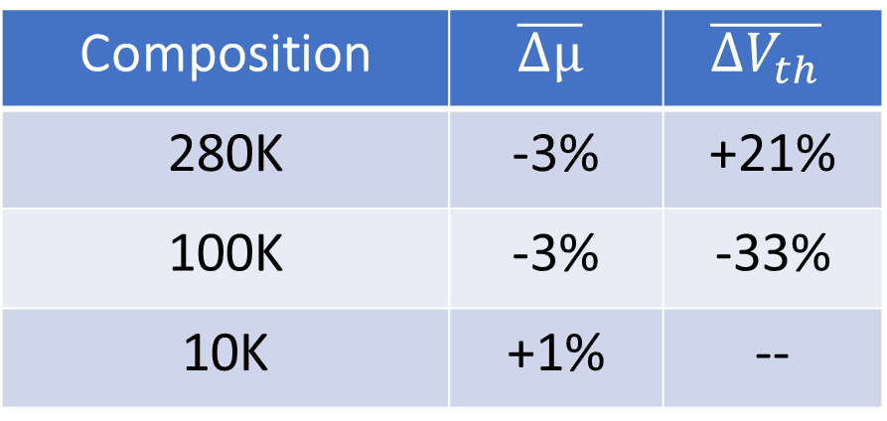
Resume on electical parameters variation after X-rays irradiation
Composition | $$\overline{Δµ}$$ | $$\overline{{ΔV}_{th}}$$
280K | -3% | +21%
100K | -3% | -33%
10K | +1% | --

Slide 35
Conclusions
The electric parameters are better in samples with lower MW
Sensitivities are negative in 100K and 10K samples and are calculated from «triangle-like» photocurrents
After irradiation, mobilities show values comparable to the previous ones

